Slide 1
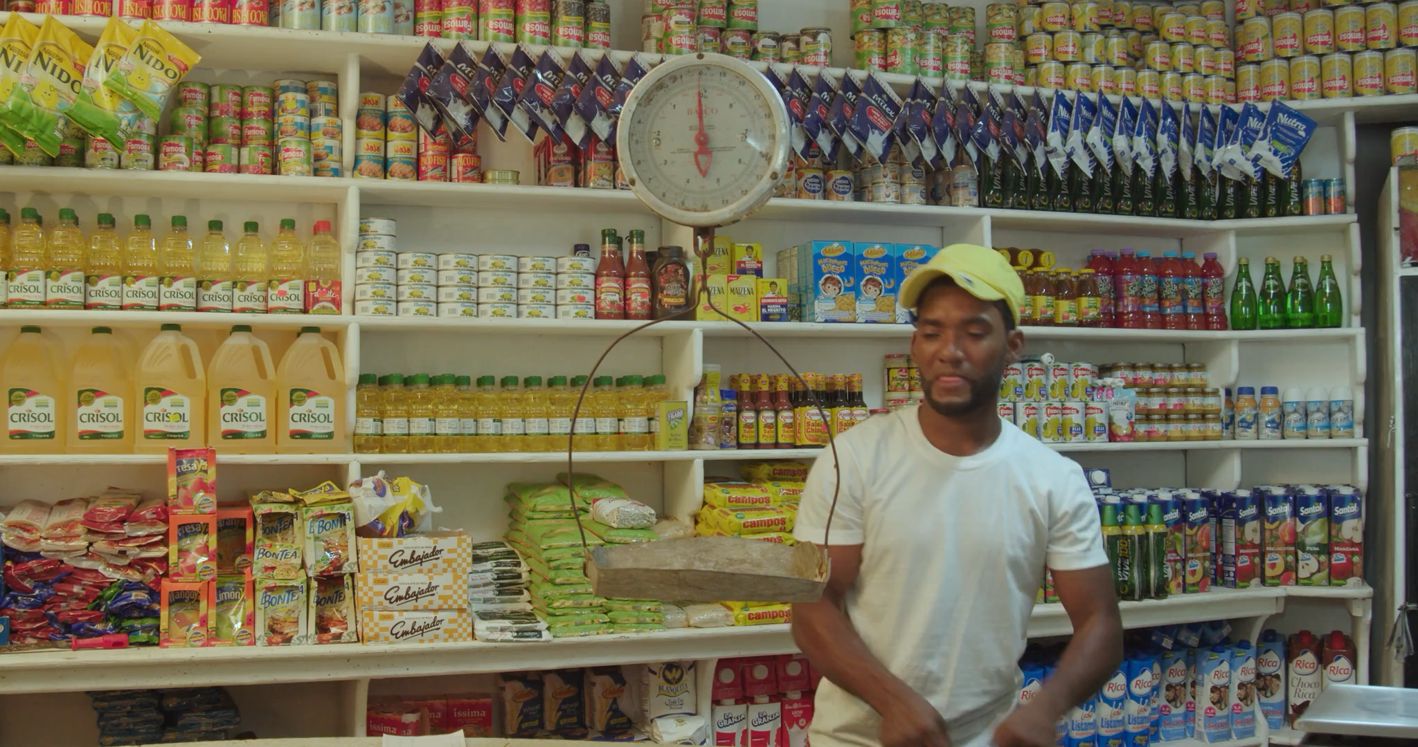

Notes:
https://pixabay.com/videos/man-store-shop-supermarket-208777/

Slide 2


Notes:
https://pixabay.com/videos/ai-generated-woman-sleep-sleeping-200968/

Slide 3

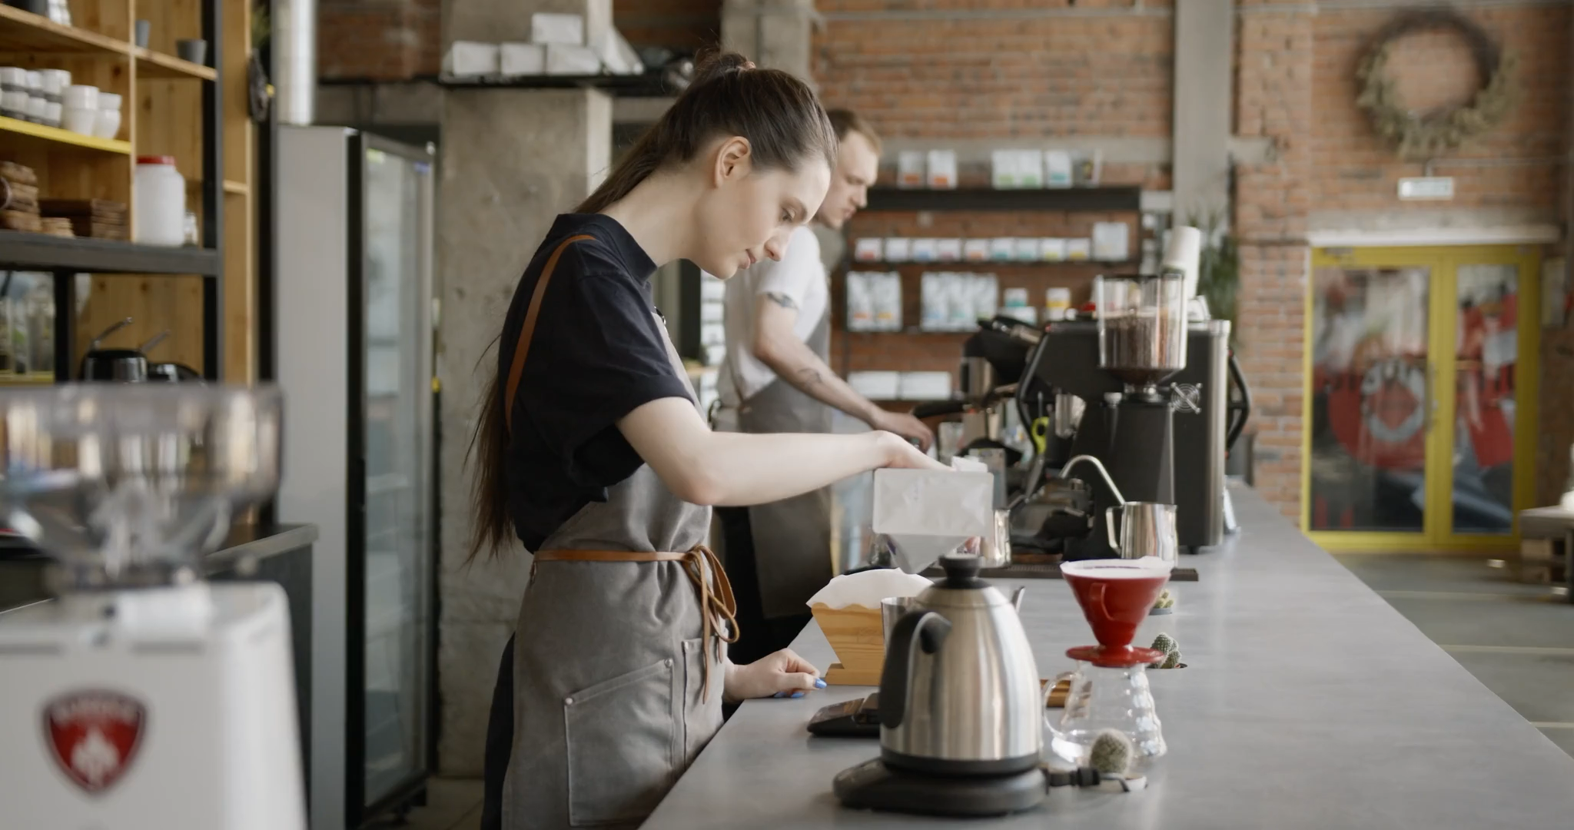
Notes:
https://pixabay.com/videos/coffee-cup-mug-drink-133988/

Slide 4

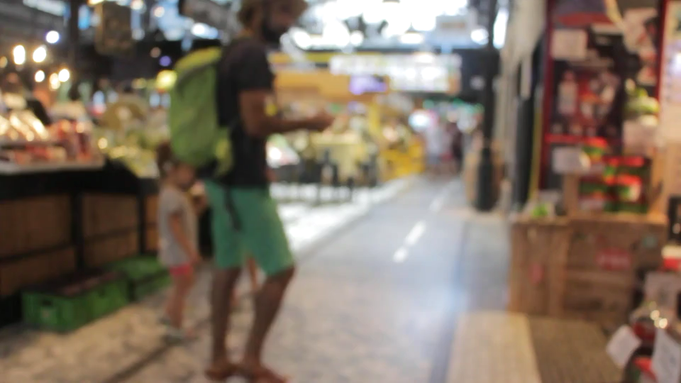
Notes:
https://pixabay.com/videos/indoor-market-vegetable-market-4730/

Slide 5

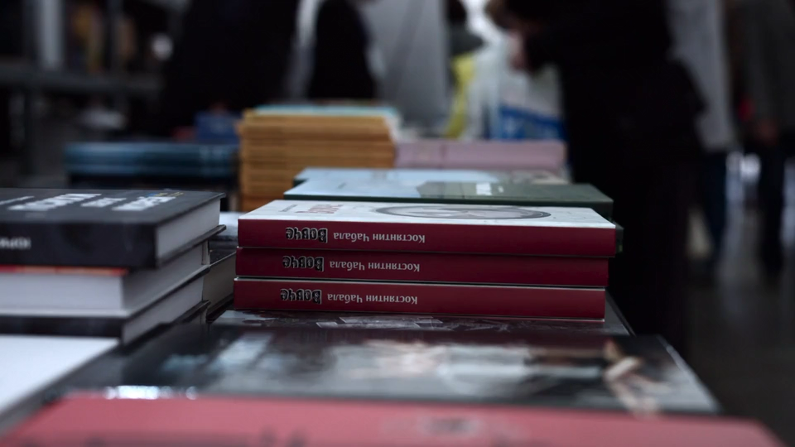
Notes:
https://pixabay.com/videos/book-shop-people-reading-tutorials-39888/

Slide 6

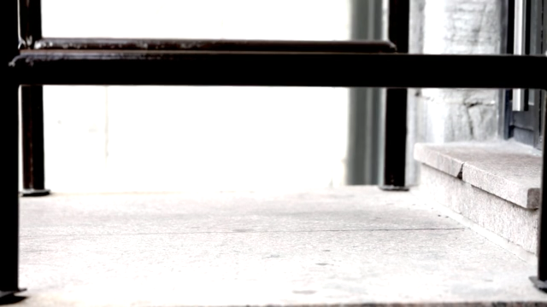
Notes:
https://pixabay.com/videos/doorstep-steps-stairs-entry-walk-297/

Slide 7

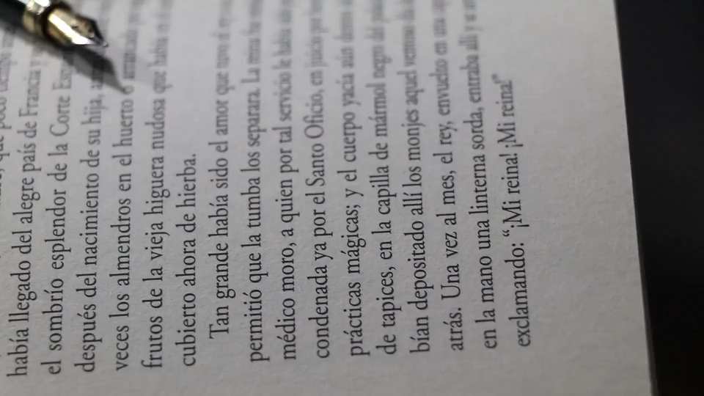
Notes:
https://pixabay.com/videos/book-pencil-notebook-paper-41121/

